Slide 1
PORTFOLIO
Software Engineer
Signal processing/Machine learning/Acoustic engineering /Optimization problems/Blind Source Separation/Auditory Scene Analysis
Seoul National University of Science & Technology
Mechanical System Design Engineering
Sonmook Oh(Luke)

Slide 2
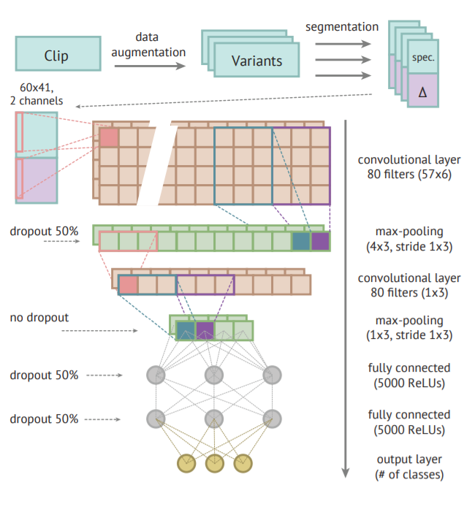
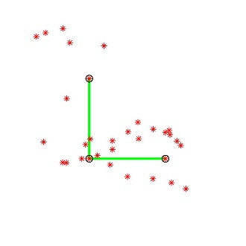
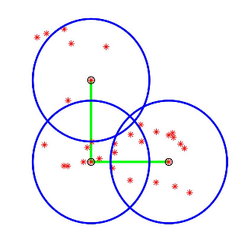
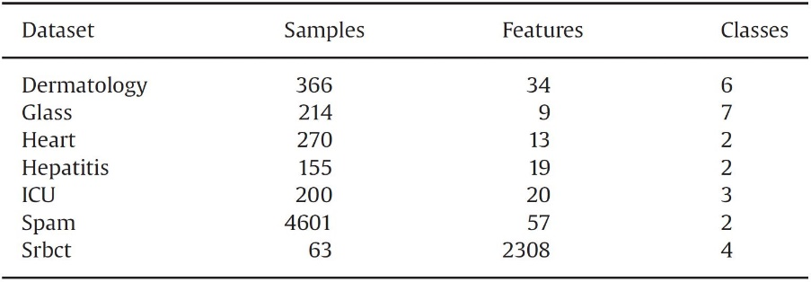
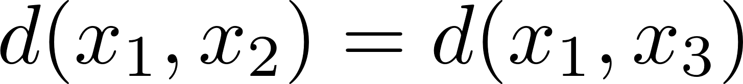
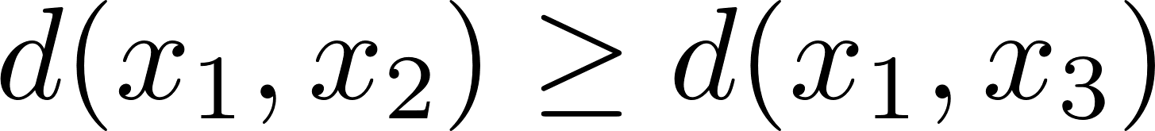
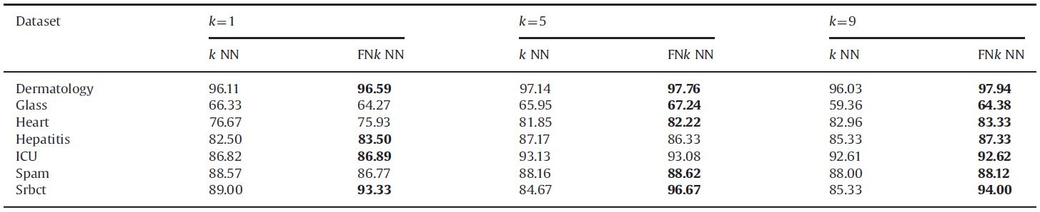
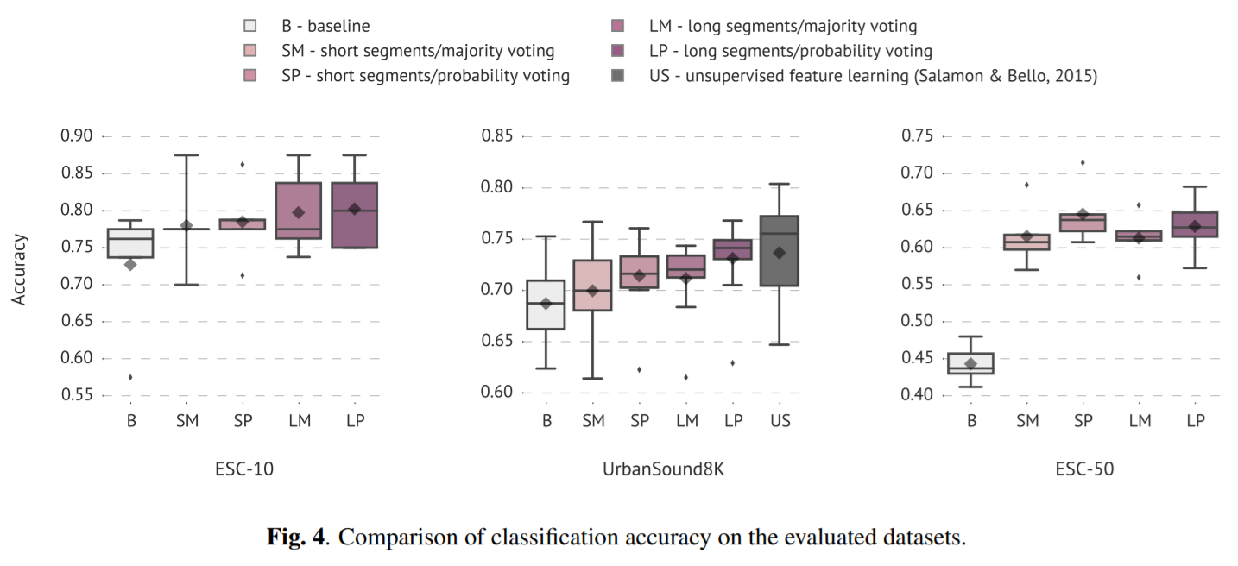
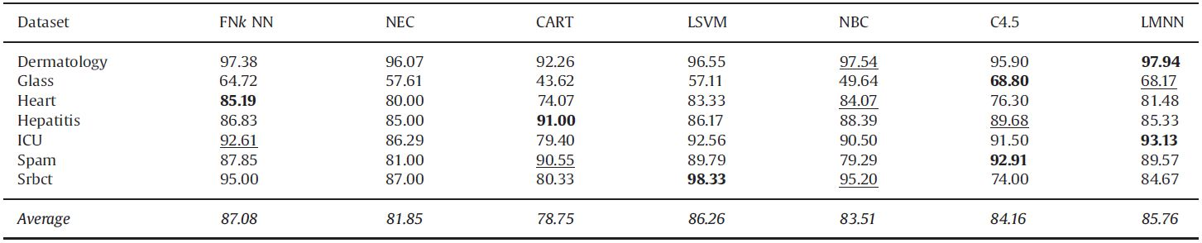







Coursework Projects
※ Journal implementation & analysis
Intelligent System
1)
Advanced Machine Learning
Neighborhood Information and It’s Influence
Datasets
2)
$$x_{2}$$
$$x_{2}$$
$$x_{1}$$
$$x_{3}$$
$$x_{1}$$
$$x_{3}$$
Euclidean Distance
Distance Using
Neighborhood Information
From UCI datasets
2)
$$f\left(x\right)=max⁡(0,x)$$
1)
Datasets : ESC-50 dataset, ESC-10 dataset, UrbanSound8K
Karol J. Piczak., “Environmental Sound Classification With Convolutional Neural Networks,”2015 IEEE INTERNATIONAL WORKSHOP ON MACHINE LEARNING FOR SIGNAL PROCESSING, SEPT. 17–20, 2015, BOSTON, USA
Lin, Yaojin & li, Jinjin & Lin, Menglei & Chen, Jinkun. (2014). A new nearest neighbor classifier via fusing neighborhood information. Neurocomputing. 143. 164–169.

